Slide 1
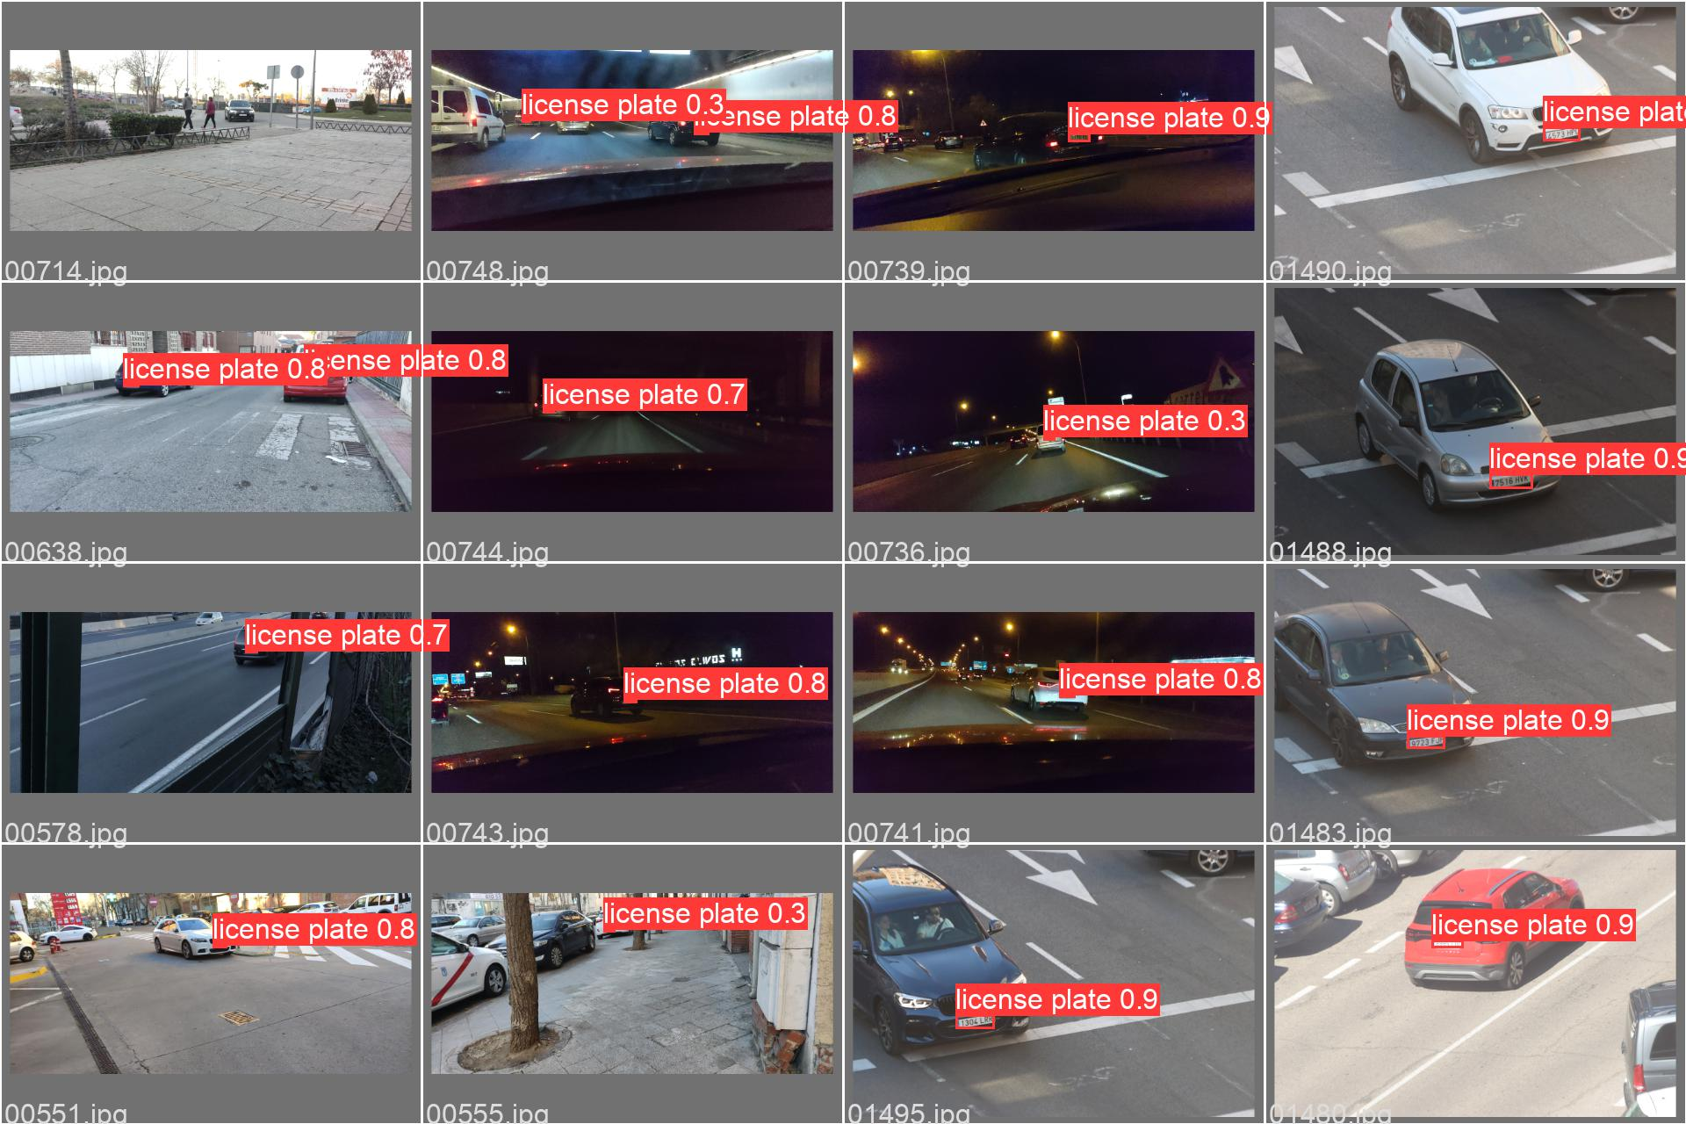

Proof-of-Concept Design of a Distributed IoT System with Edge Computing & Storage Requirements
By: Andrés Navarro Pedregal
Tutor: David Larrabeiti López
March 10, 2025. Leganés, Madrid, Spain
Dual Bachelor in Data Science and Engineering and Telecommunication Technologies Engineering

Slide 2
Table of contents
01
02
03
04
05
06
Introduction & Objectives
Technical Details
Development
Testing
Problems Encountered
Conclusions
Andres Navarro Pedregal

Slide 3
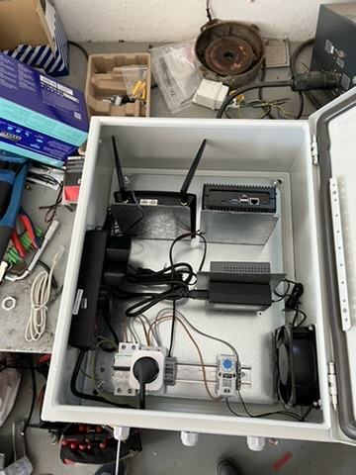
Project
Part of a collaboration with a company based in Valencia
Study the viability of a IoT System for automatic access control to private communities parkings (e.g. a condominium, a sports club, etc)
Developed in collaboration with the Automatic & Robotics Department @ UC3M
Andres Navarro Pedregal

Slide 4
Problem
💻
☁️
📸
🧍‍♂️
🚘
🚪
🏢
🏢
🏢
🏢
🏢
🏢
🏢
🏢
🏢
🏢
🏢
Andres Navarro Pedregal
Notes:
cloud

Slide 5
Objectives
Build a scalable parking management system
Make it autonomous and fully automated
Create a adaptable system for smart communities
Andres Navarro Pedregal

Slide 6
Requirements
System able to recognize license plates and open gates automatically, alternatively, open with RF remote or “remote” App
Owners can manage their parking lots and authorize users to enter
Communities can be dynamically added, system must be scalable to hundred communities
Application must stored on-site encrypted and be accessible from the internet & mobile
Andres Navarro Pedregal

Slide 7
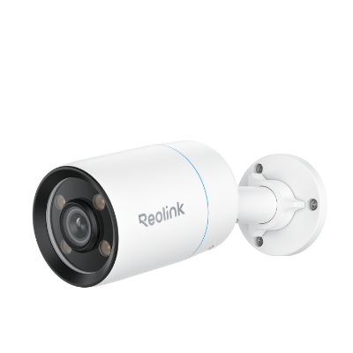

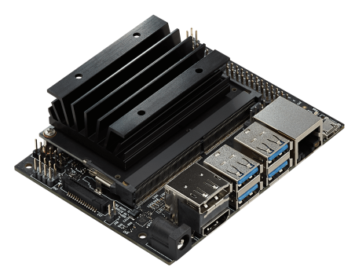
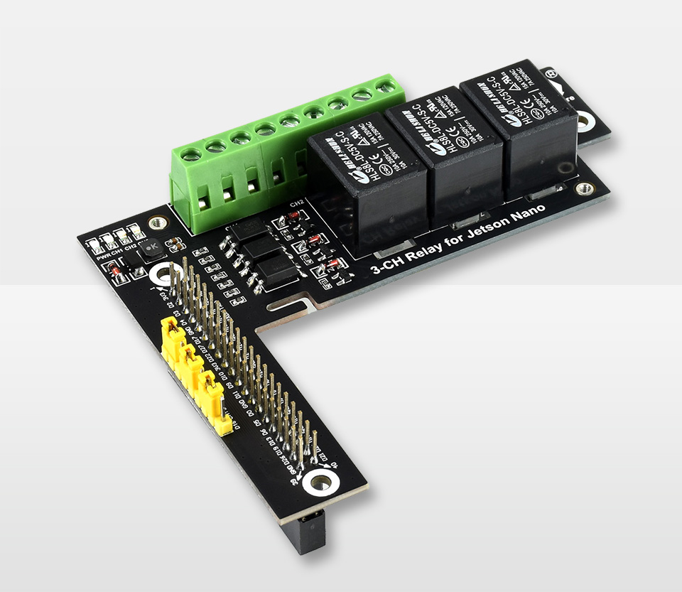



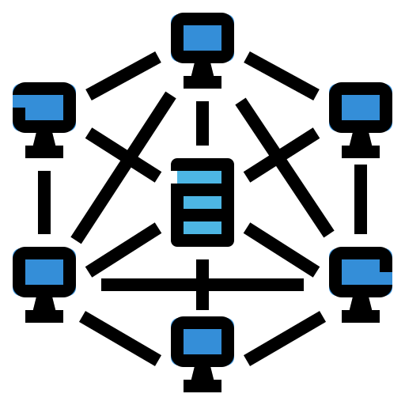


High Level Overview
Detection System
Actuators
Server
Terminal
Front-end
Back-end
Continuous Development
Networking
Database
Andres Navarro Pedregal

Slide 8
Architecture
Community
🗄️ DB
👤 User
🤖 LP Detection
⚙️ Terminal
☁️ Server
🦾 Actuators
…
Community N
CD
Andres Navarro Pedregal

Slide 9
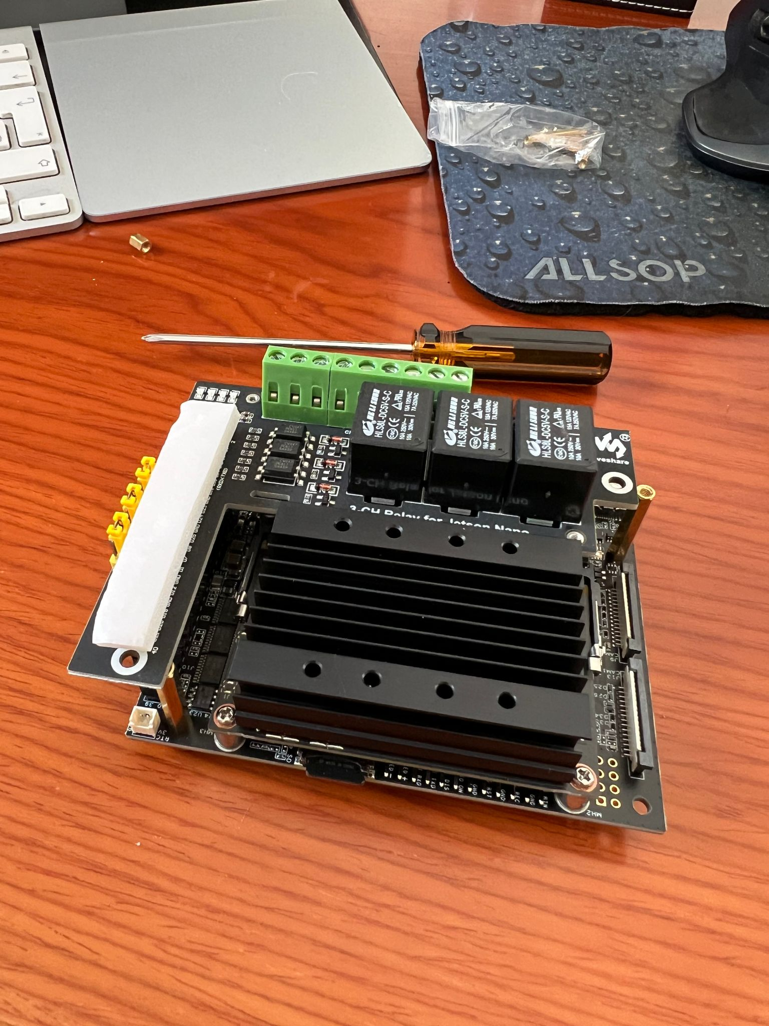
Terminal
Brains of the operation, Jetson Nano
API for the outside -> ExpressJS
Licence Plate Detection -> YOLO with PyTorch
* Plate detection and OS tuning work to fit into Jetson Nano developed by Álvaro Ramajo
Andres Navarro Pedregal

Slide 10
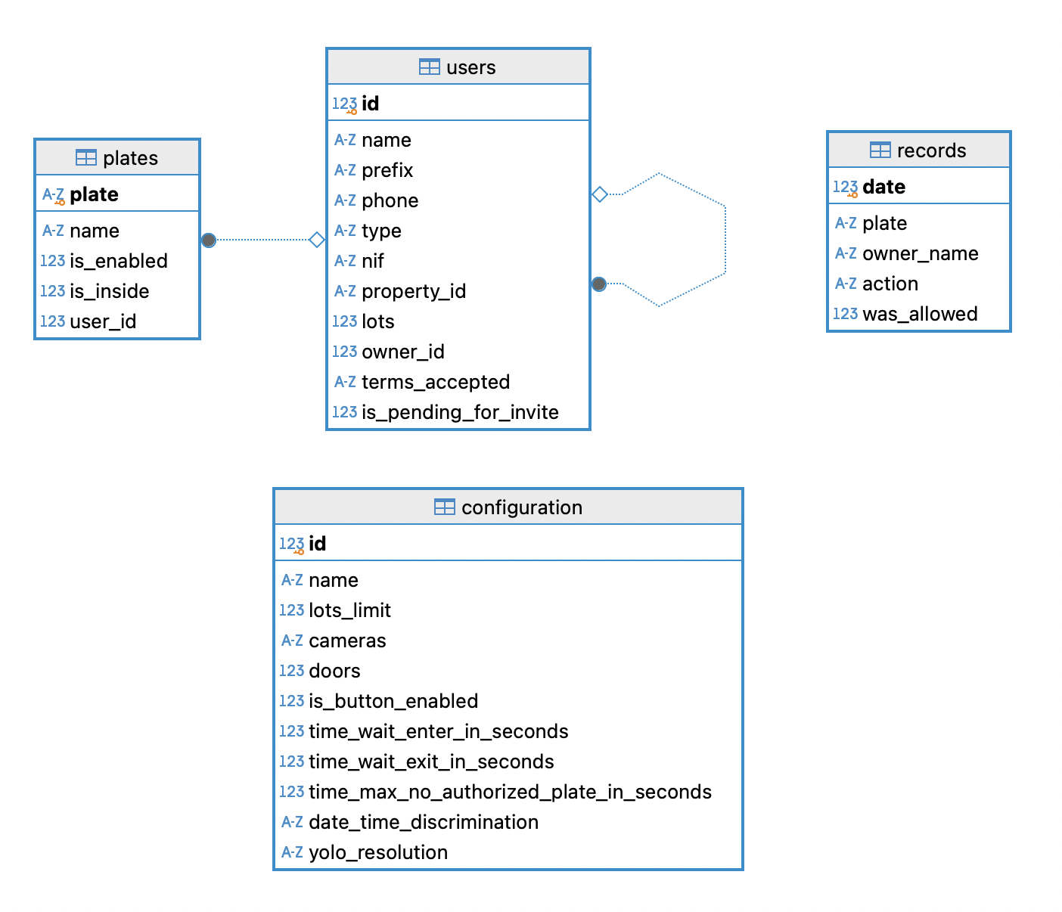
Database
Local DB with data encrypted
Backups on the cloud
Andres Navarro Pedregal

Slide 11
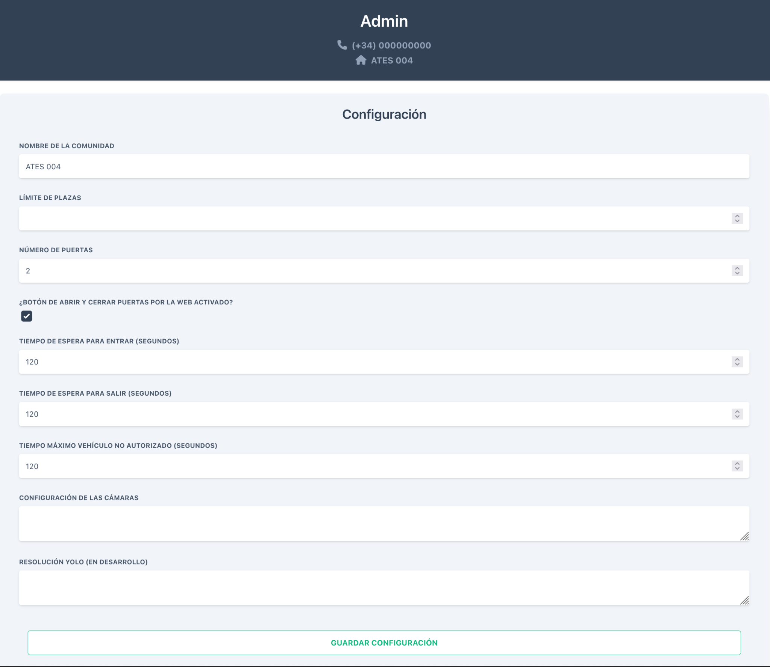
Server
Acts as the proxy to let users interact with the community
Backend -> NextJS
Frontend -> React
Relays all request to the specific community
Andres Navarro Pedregal

Slide 12
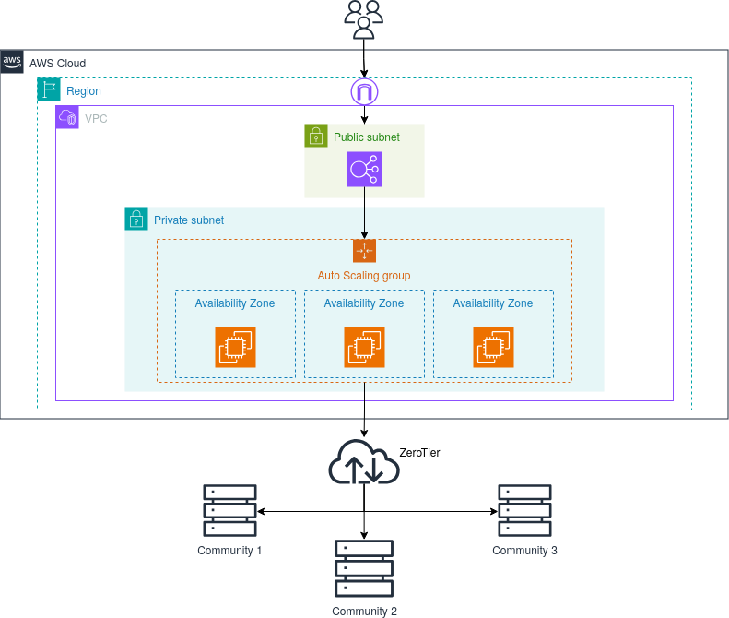
Server Architecture
Andres Navarro Pedregal

Slide 13
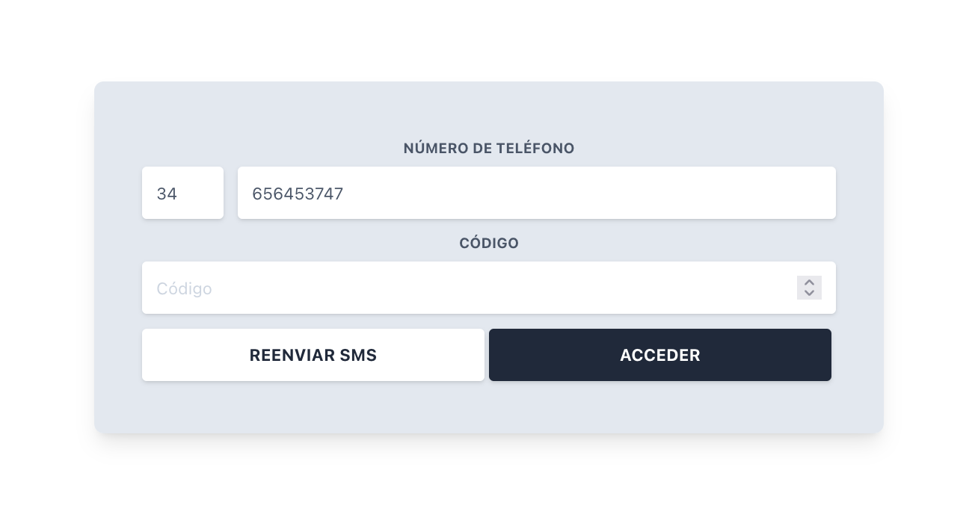
Authentication
Firebase
SMS login
JWT tokens
Andres Navarro Pedregal

Slide 14
Multi-Community
🏠 Community 1
👾 Server
🏠 Community 2
☁️ Internet
🌐 ZeroTier
…
🧍User
🏠 Community N
Andres Navarro Pedregal

Slide 15
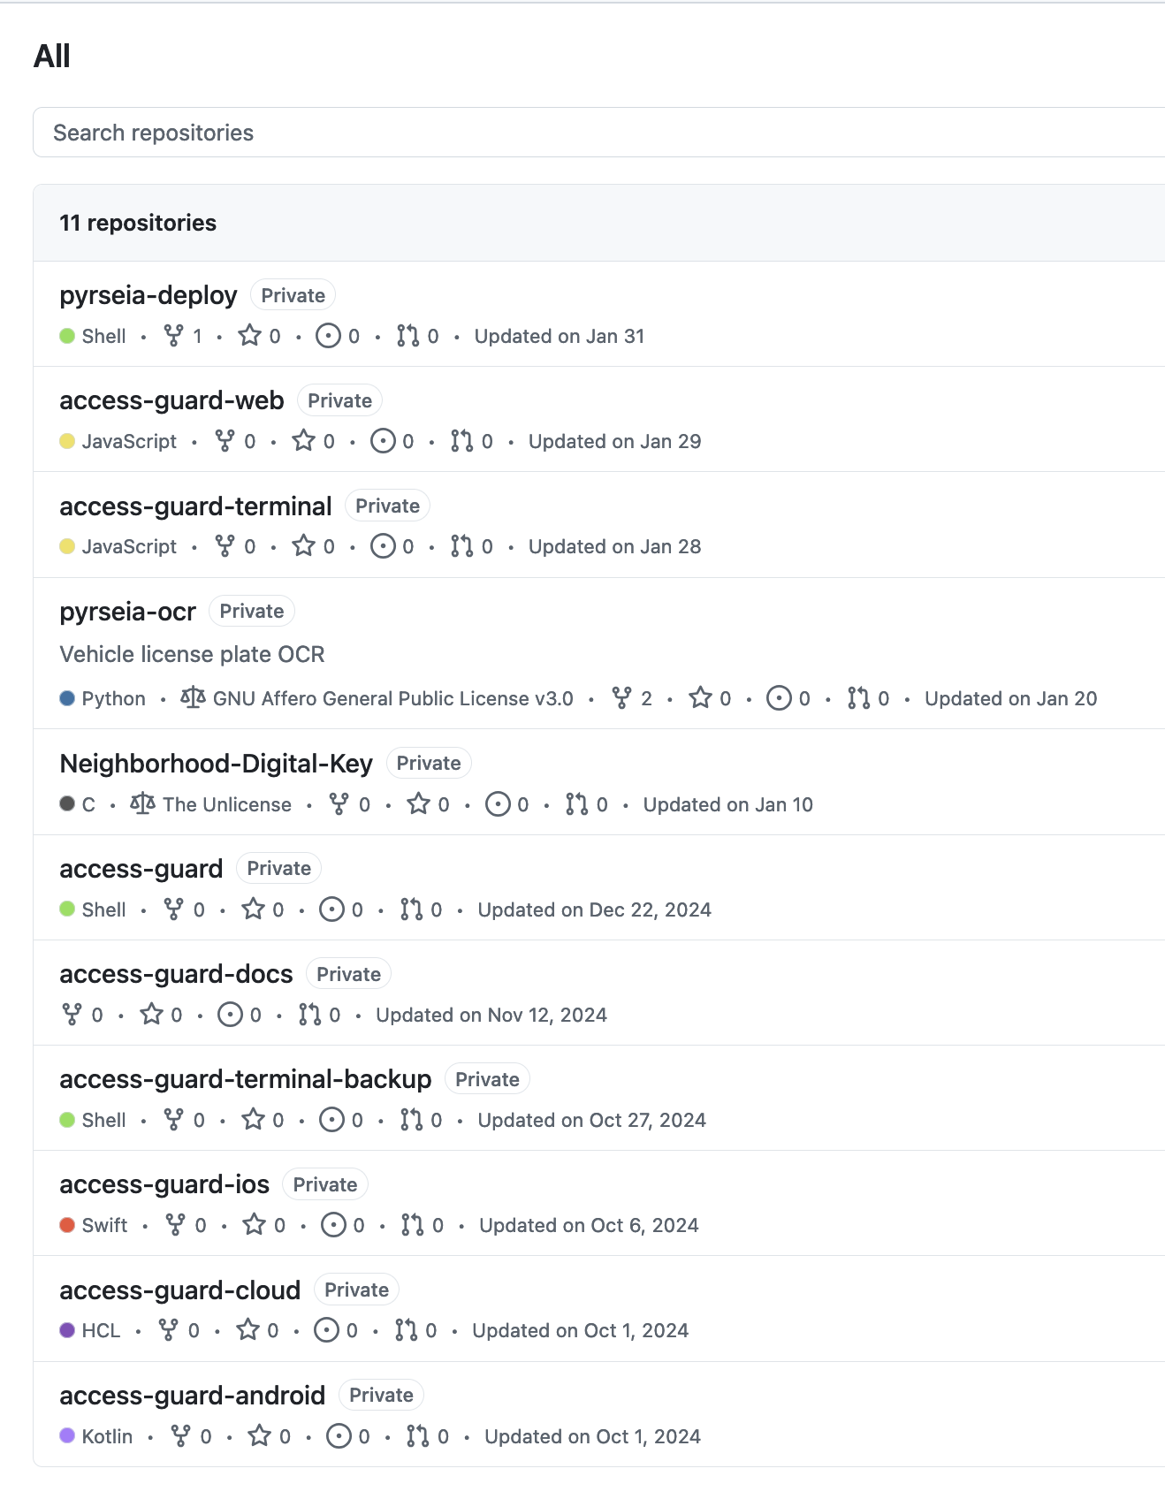
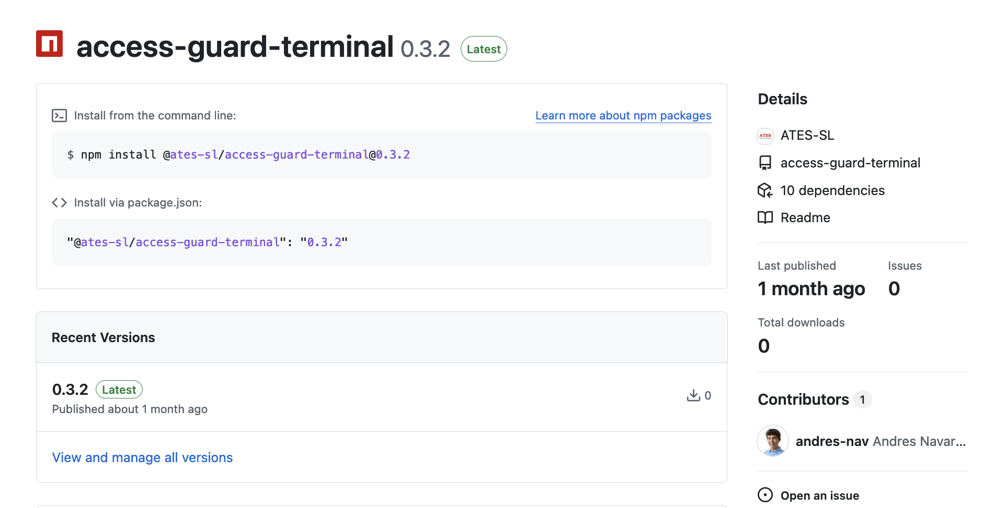
Deployment
GitHub Actions: build packages
Ansible: make the upgrades automatically (under development)
Andres Navarro Pedregal

Slide 16
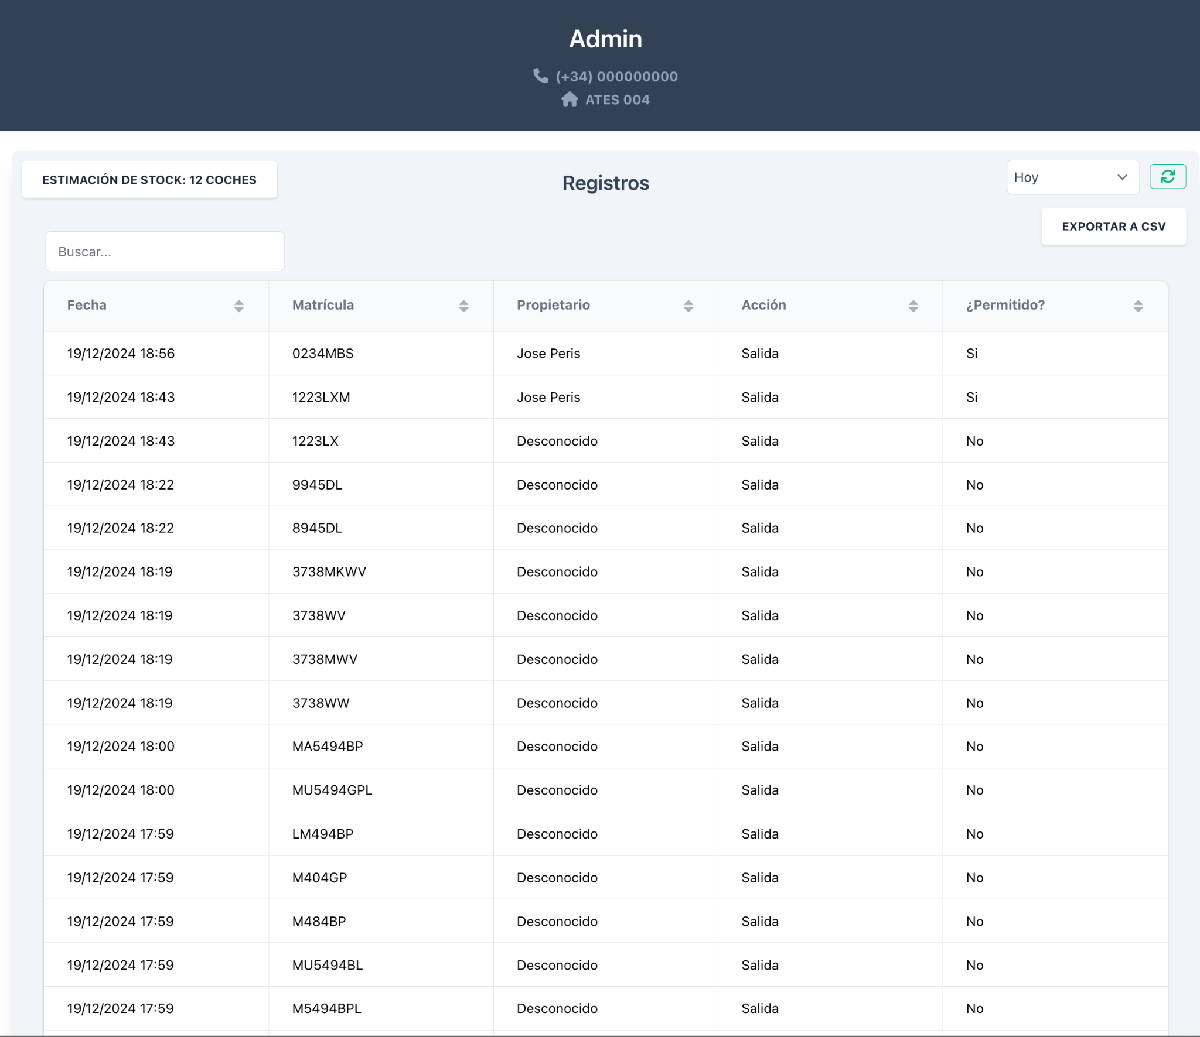
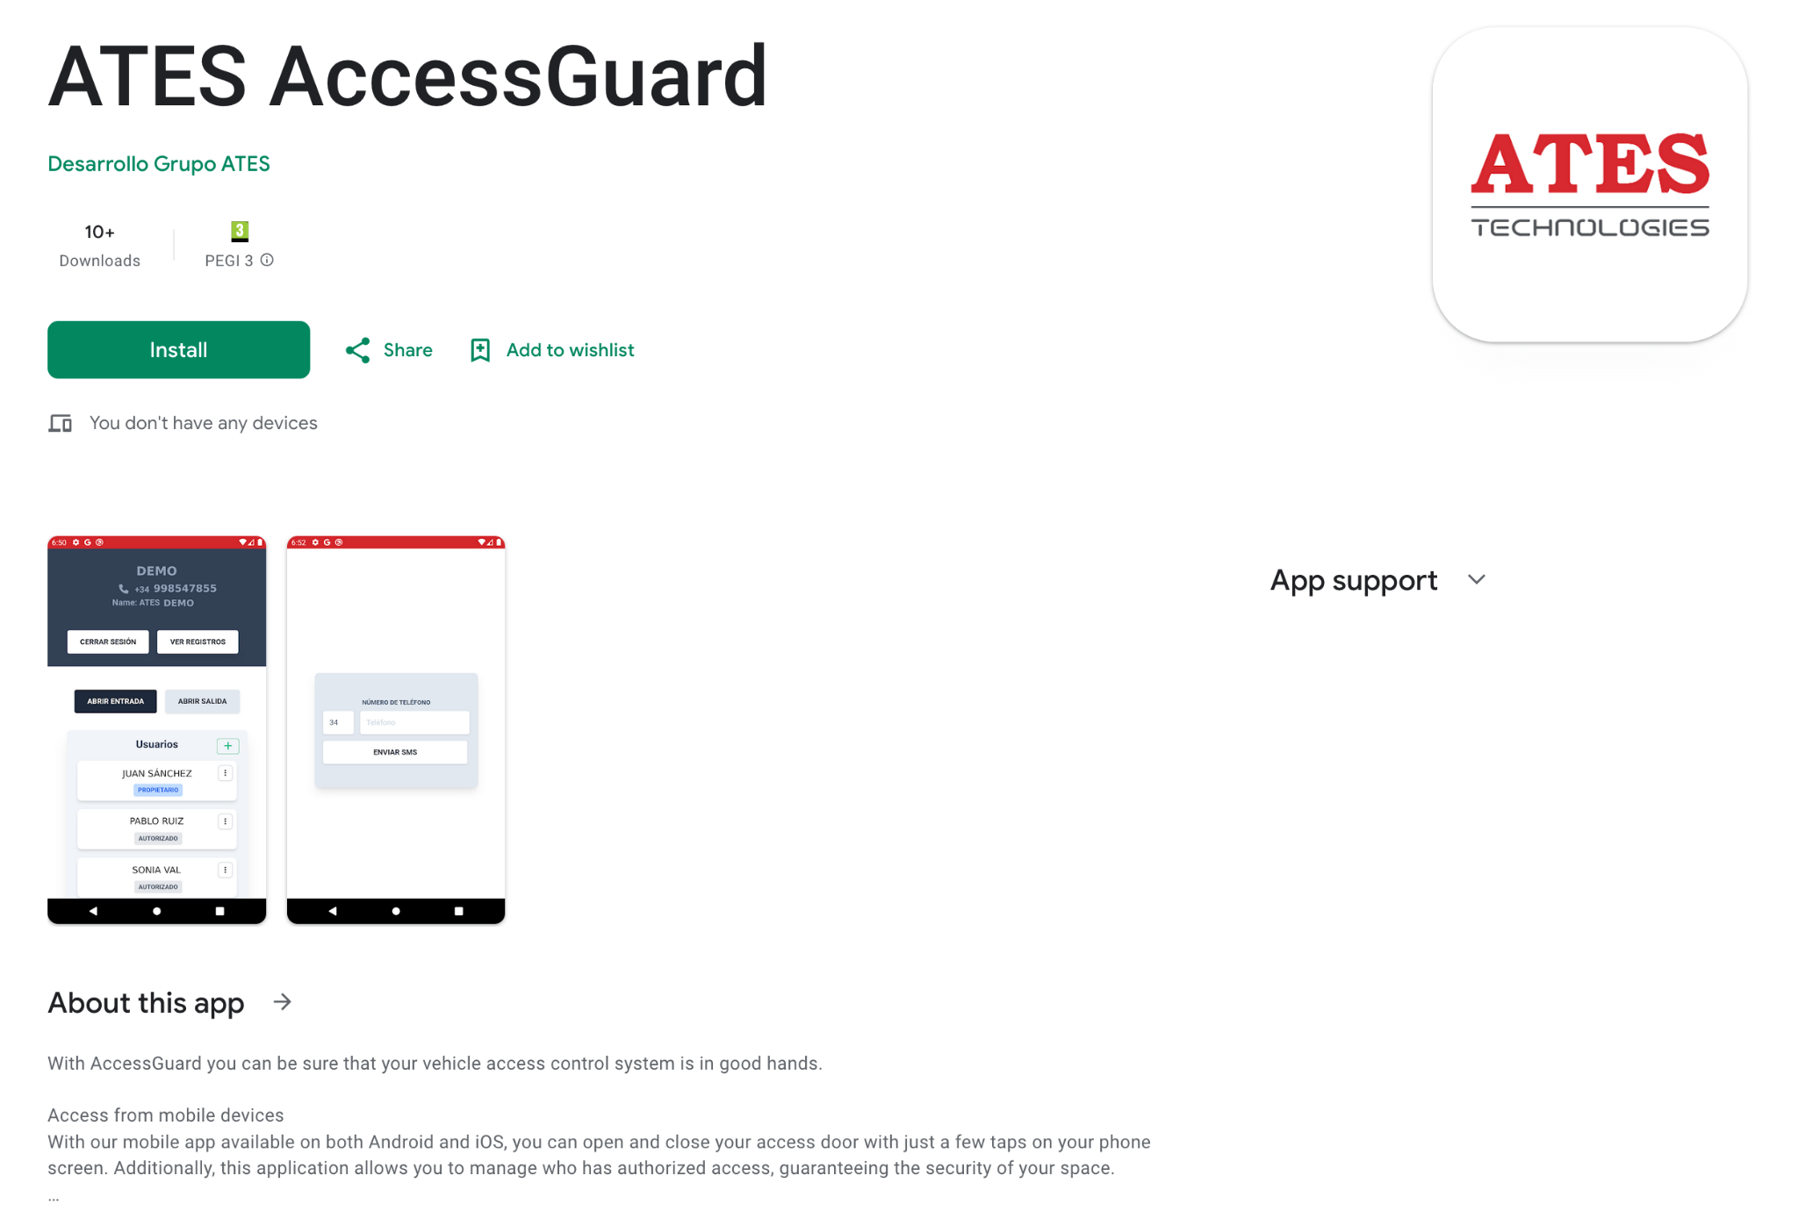
User Interface
Andres Navarro Pedregal

Slide 17

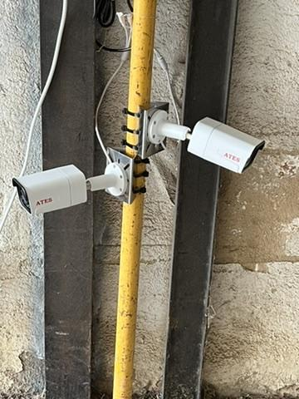
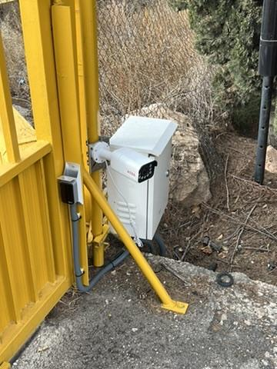

Testing
Andres Navarro Pedregal

Slide 18
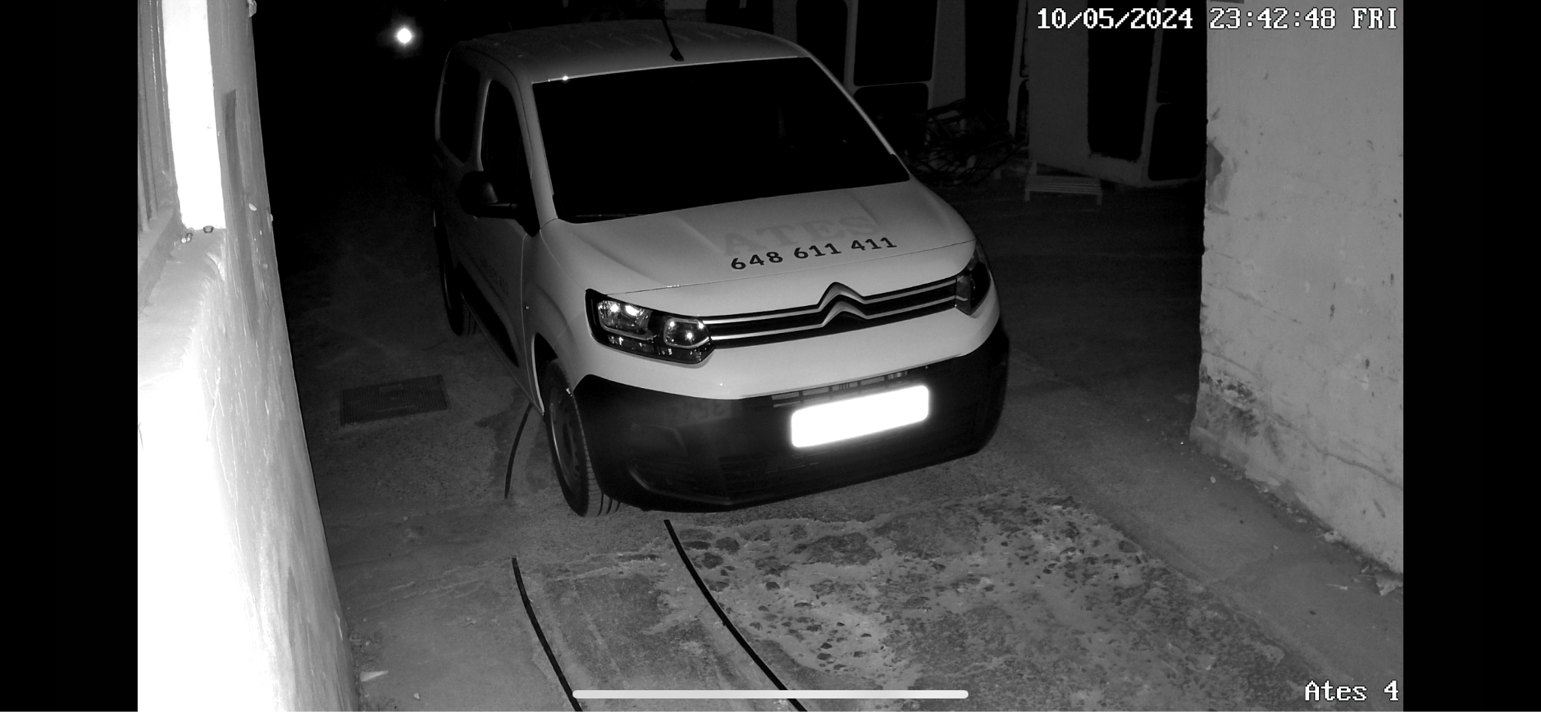
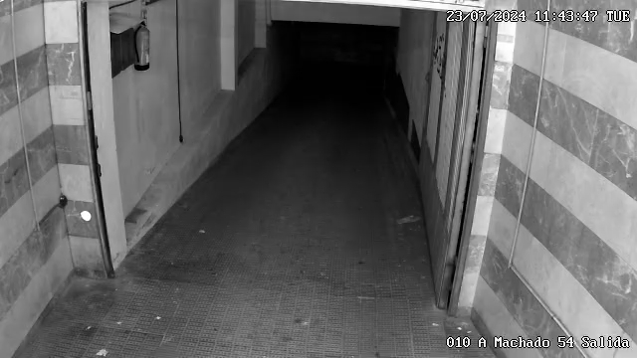
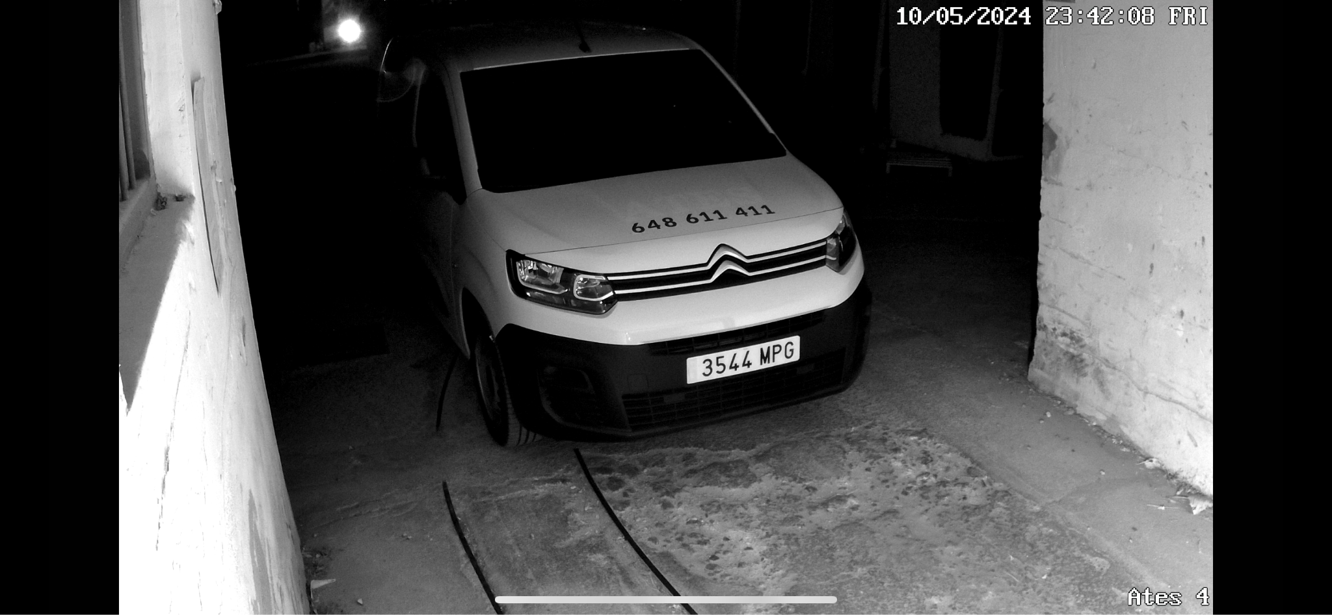
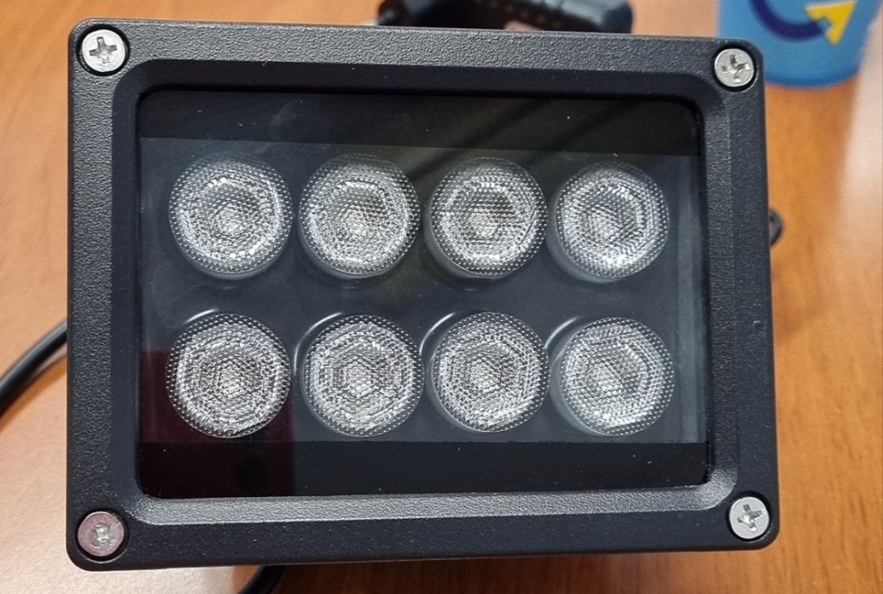
Low Lighting Problems
Fixed with Infrared Lights
Andres Navarro Pedregal

Slide 19
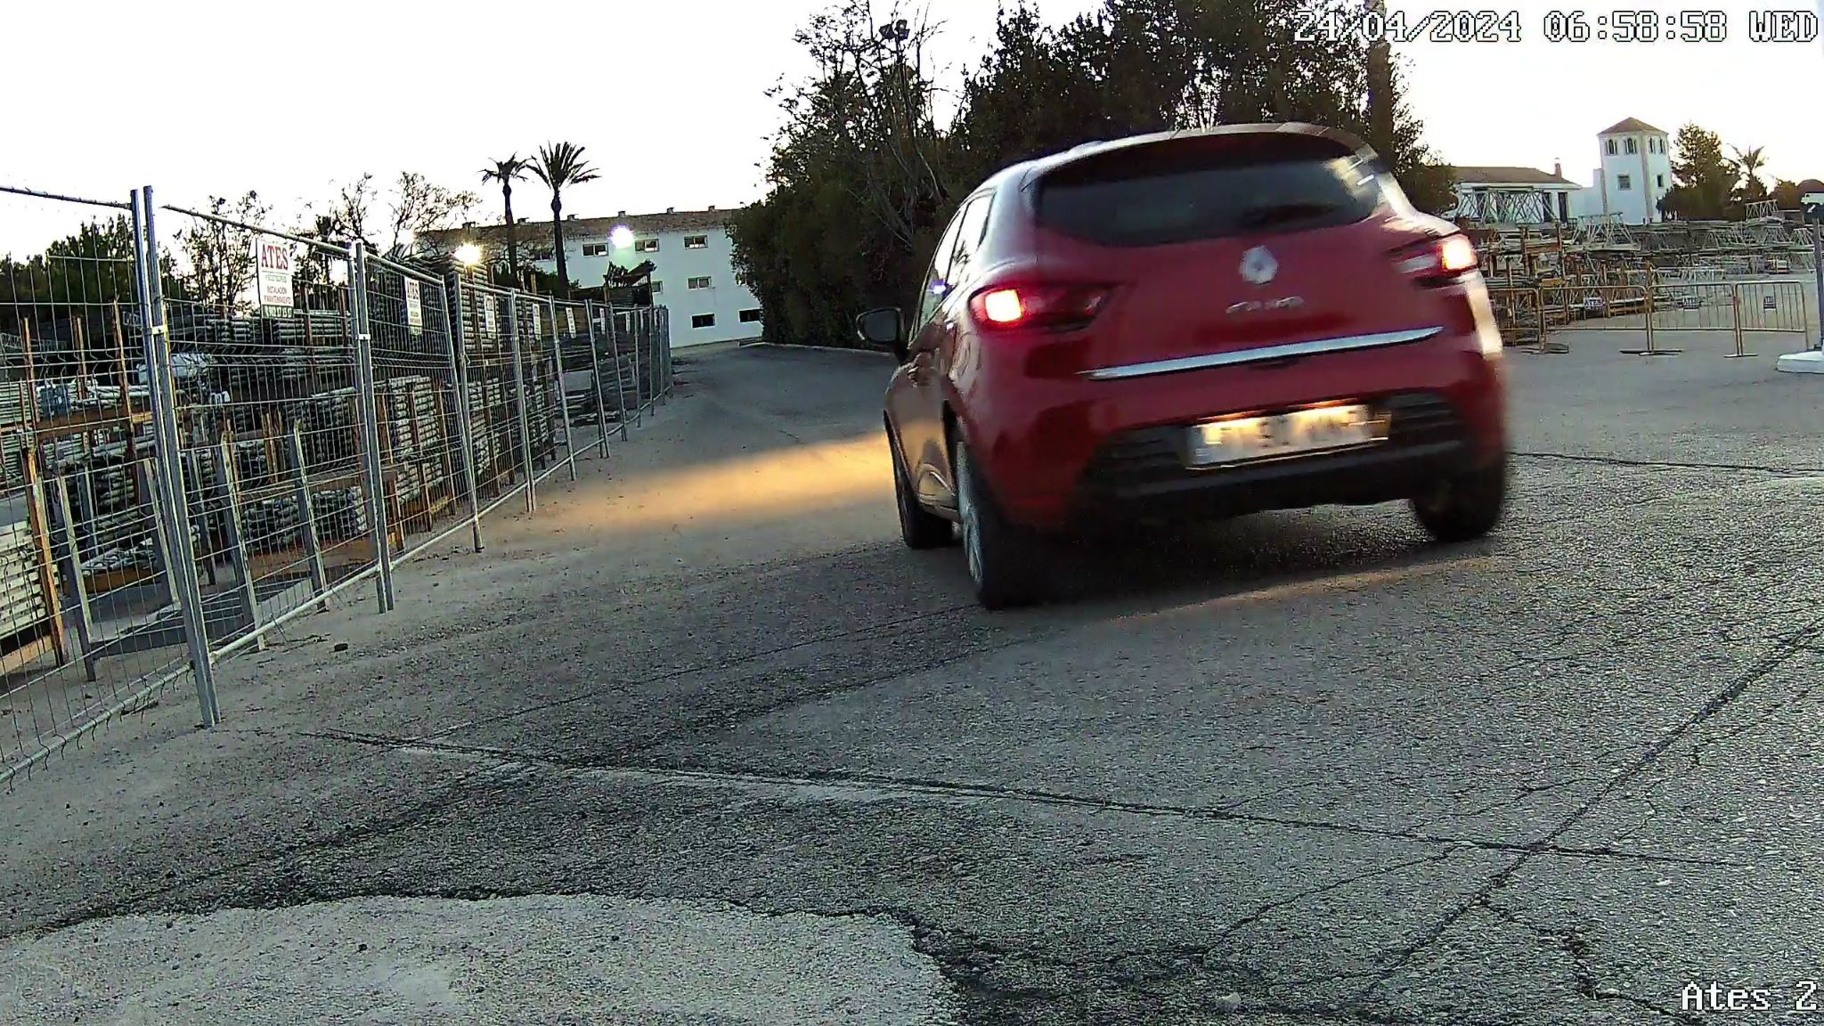
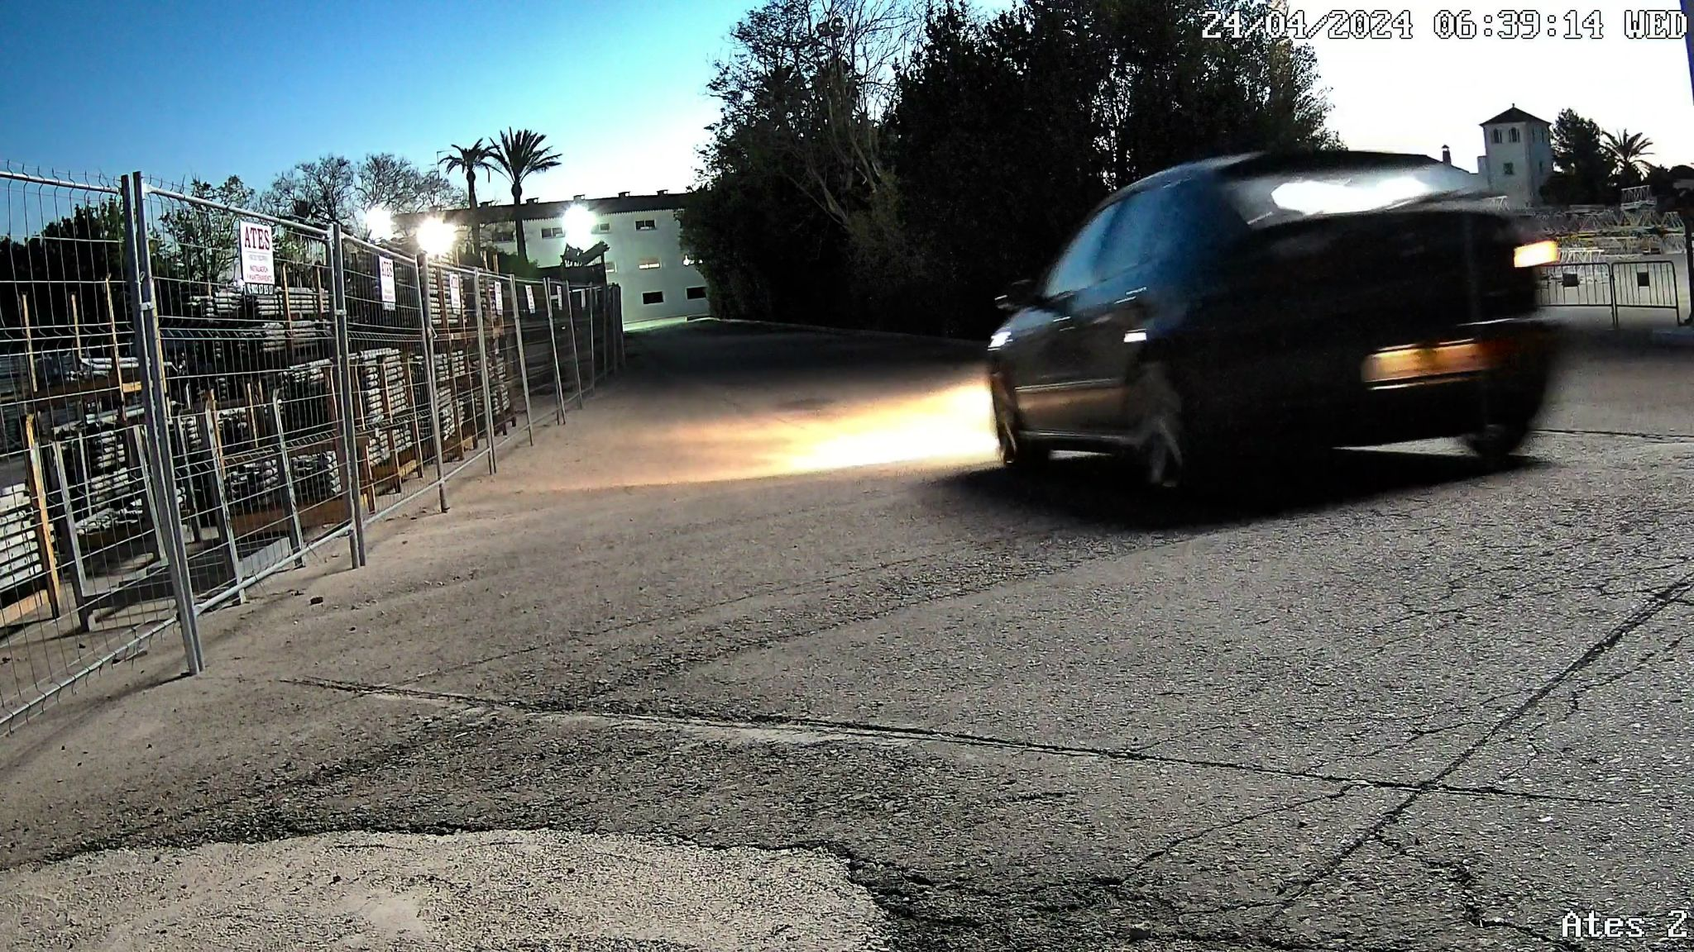
Speed
Andres Navarro Pedregal

Slide 20
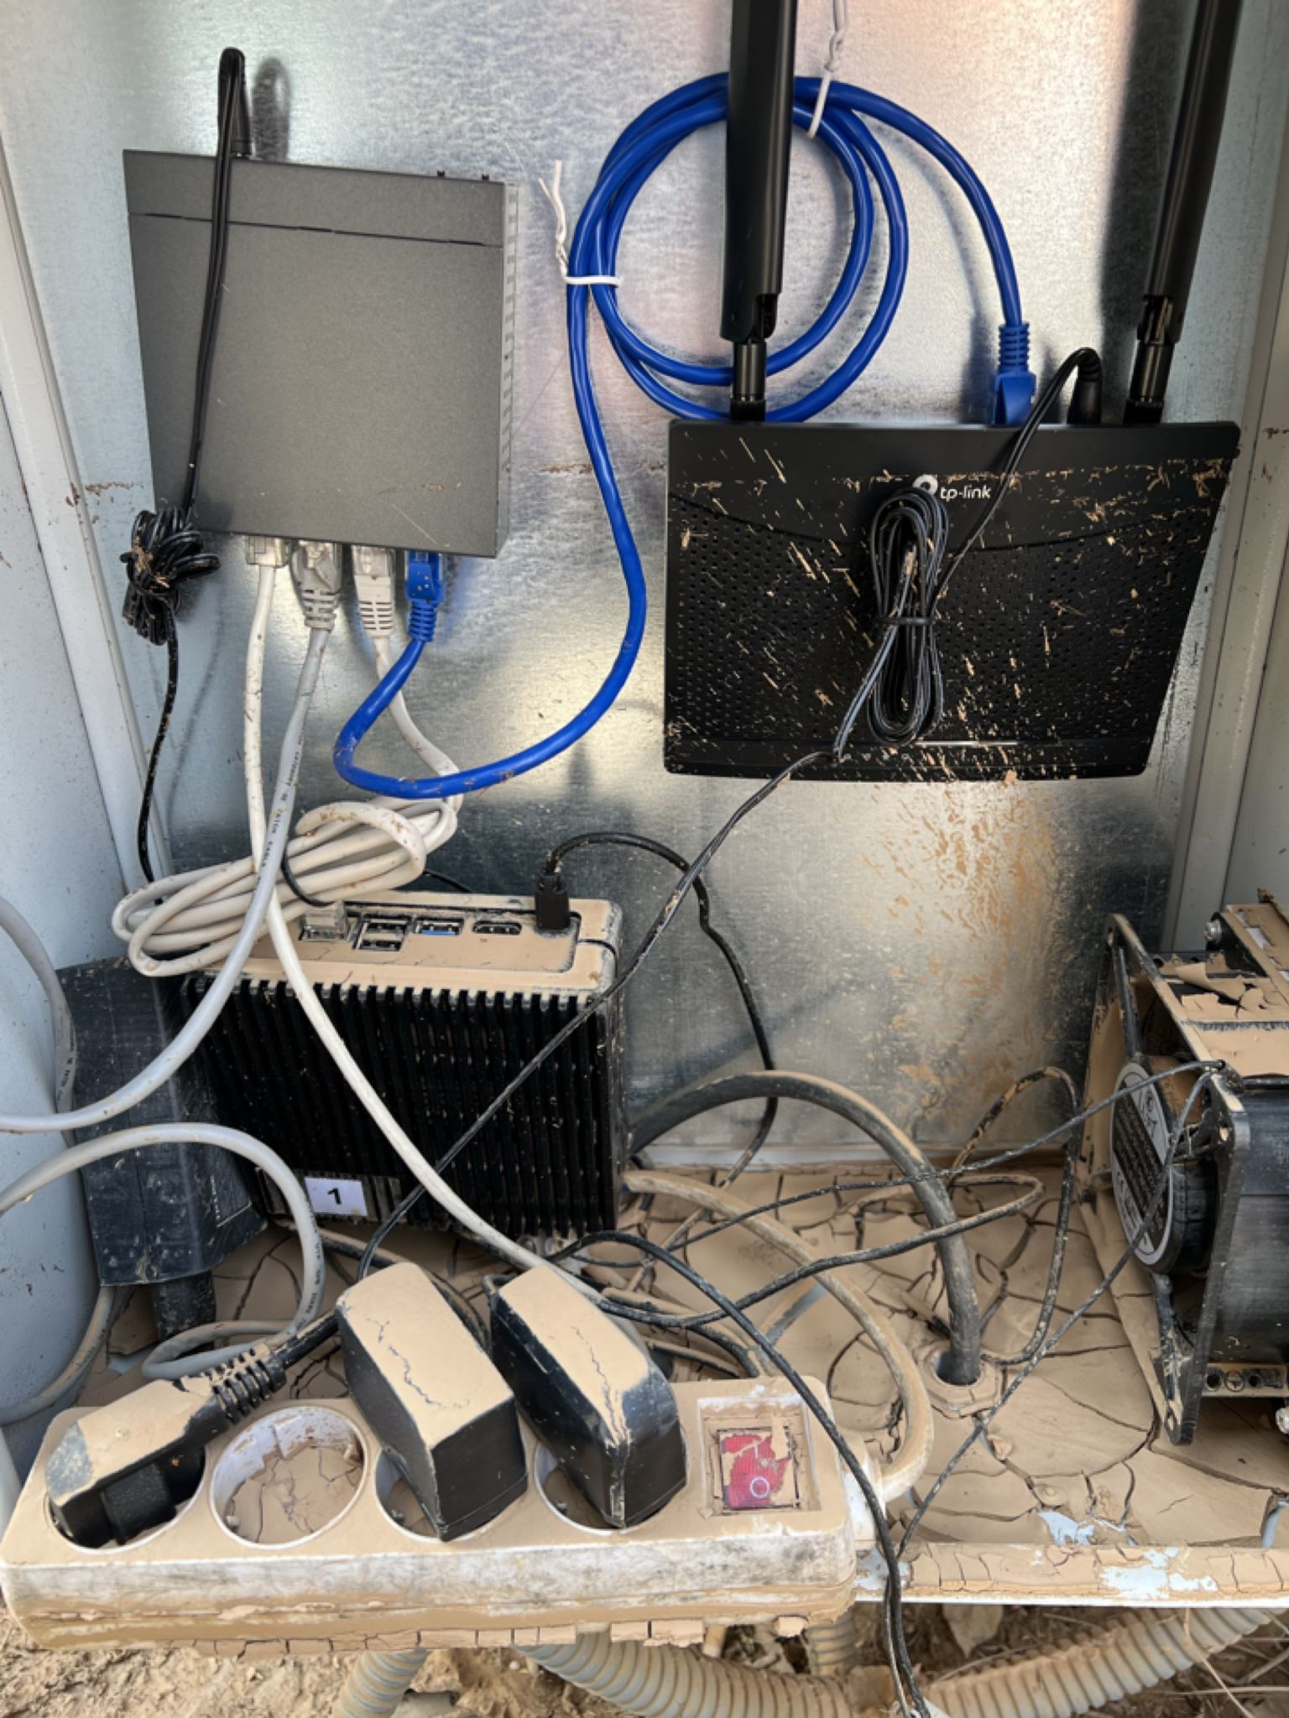
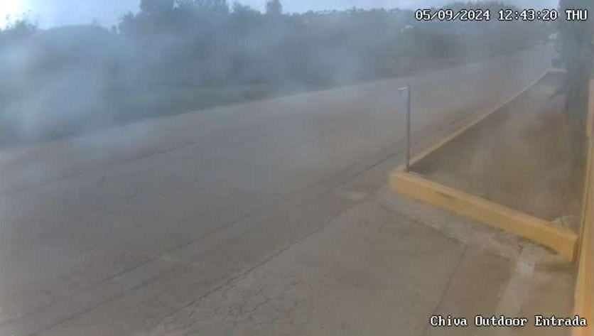
Weather
Andres Navarro Pedregal

Slide 21
8 communities
99% uptime
Automatic detection
Andres Navarro Pedregal

Slide 22
Lessons
Proof-of-Concept Design of a Distributed IoT System with Edge Computing & Storage Requirements
Develop a software project from start to end:
Full design cycle: requirements, specification (architectural design), implementation and testing in a real production environment
Many technologies involved !
Communicate with stakeholders
Troubleshoot different problems
The importance of monitoring and logging
Further work planned in scalability, resiliency and monitoring
Andres Navarro Pedregal

Slide 23
Thank you!
Any questions?
Andres Navarro Pedregal

